Slide 1
Unlocking Multi-Platform Database Secrets
What is the “Swiss Army Knife” of Database Knowledge?

Slide 2




About me
Kellyn Gorman
Engineer and Advocate
Kellyn.Gorman@red-gate.com
https://linkedin.com/in/kellyngorman
https://dbakevlar.com

Slide 3

The What of the Session
What is Multi-Platform
Popular Database Platforms
What it Requires
How to Navigate
In Summary

Slide 4

What is Multi-Platform?

Slide 5

In the Database World
Multi-platform is our version of a full-stack developer-
Knowledgeable of multiple database platforms.
Has utilities and tools available to manage and maintain each platform.
Understands differences, especially *nuances* in each platform.

Slide 6
Mindset required for MP database Work
Curious mind
Open minded
Desire to understand the real reason behind an issue
Strong research skills

Slide 7

Multi-Platform Support Occurs for various Reasons
Necessity due to technical debt.
User base choices
Cloud journey
Migrations from enterprise to open-source.
Each of these scenarios or combinations often decide what database platforms you will end up managing.

Slide 8

Popular Database Platforms

Slide 9
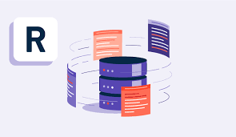
Relational Enterprise DBs
Oracle
SQL Server
DB2
Sybase
These are all client/server based installations, (primarily) and have been around for 40+ years

Slide 10

Open-Source Relational DBs
MySQL
MariaDB
PostgreSQL
MongoDB(CosmosDB, DynamoDB)
These are the upstarts, the cloud databases that are often used to replace the enterprise databases.

Slide 11

Analytical
Snowflake
Databricks
*Fabric
For analytics or data warehouse workloads, these are capturing a significant percentage of the marketplace.

Slide 12

Other Popular Databases
Google Big Query
Splunk
SQLite
Apache Hive
Redis
Elasticsearch
Apache Cassandra

Slide 13
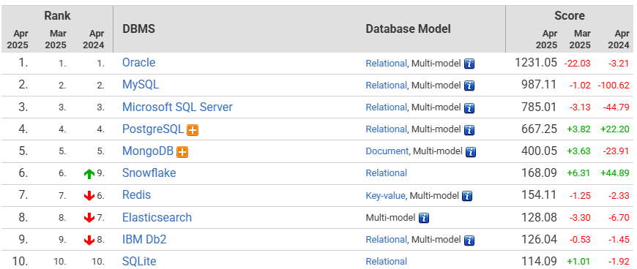
How Popular are each?
https://db-engines.com/en/ranking

Slide 14
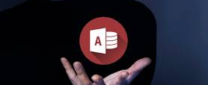
Let’s Get this out of the way…
I don’t consider Microsoft Access or Microsoft Excel “databases”.

Slide 15
What will this require from a DBA or Developer?

Slide 16
All Databases Have a primary Responsibility
Every database platform is primary for the following:
Store data
Secure data
Insert, update, delete data
Query data
Database Platforms are broken down into the following categories
Relational
Document
Key-Value
Graph
Vector
“Other”
Secondary category: Multi-model

Slide 17
All databases are Not for all workloads
One of the biggest mistakes I see is using the wrong database for the workload!
Database Type | Workload Usage
Relational | Transactional, (fintech, retail, mfg) highly normalized data. Some handle JSON and other document structures well and recently, some vector data.
Vector | AI chatbots, RAG(Retrieval Augmented Generation) apps, Audio and voice recognition programs, biometric ID systems
Document | Content management systems, product catalogs, IoT applications – very denormalized data
Key-Value | Session management, retail shopping carts, High-throughput and message queues
Graph | Cybersecurity, Supply chain, Semantic web applications and social network tracking for connections.

Slide 18
Key Learning Areas for All
Operating System Management for Databases
Operating System Security for Database Systems
Understanding of storage management
Knowledge of host and cloud infrastructure- CPU, memory and different storage.
OS level scripting languages such as BASH, Python, Powershell

Slide 19
High Level Database Knowledge
Terminology- same terms, different definitions!
Term | Oracle | SQL Server | MySQL | PostgreSQL
Database | Only the files connected to an Oracle instance | Files and Processes belonging to an instance | A structured collections of data – aka a schema | A PostgreSQL Server Process and files
Instance | Background processes and memory | Software installation | The single background process for the MySQL database | Self-contained installation of Postgres
Cluster | Real Application Cluster- a single database with multiple nodes | Clustered index, (sorted and only one per table) | Distributed database architecture for HA | A collections of databases managed by a single PostgreSQL server instance.
Schema | A user | A namespace | A database | A namespace

Slide 20
Platform Tools
Platform | Command Line | Admin Tool | Developer Tool
Oracle | SQL*Plus/SQLcl | Oracle Enterprise Mgr | SQL Developer
SQL Server | SQL Prompt | SSMS | VS Code
PostgreSQL | psql | pgAdmin | Dbeaver, DataGrip
MongoDB | mongosh | MongoDB Compass | Compass, Studio 3T and VS Code
MySQL | mysql client | MySQL Workbench | Workbench,phpMyAdmin, Dbeaver, DataGrip
Snowflake | SnowSQL | Snowsight | Snowsight, DBT, Dbeaver, DataGrip
Databricks | Databricks CLI | Workspace UI | DB Notebooks, Connect, VS Code, DataGrip

Slide 21
How to Navigate the Multi-Platform DB Universe

Slide 22
Take Time in Each Platform
Don’t attempt to learn more than one at a time.
Your brain needs time to not just absorb, but to “categorize” the knowledge for the platform.
Identify the best resources for learning and have a goal of what you need to know.
Some platforms cover a wide birth, (such as Oracle) and should be taken in bite-size chunks so as to absorb.

Slide 23
Find the Resources
Platform | Resources
SQL Server | Microsoft Learn, blogs and SQL/Data Saturdays
PostgreSQL | Postgres Weekly Newsletter, blogs and PG Groups, PG Conferences and there’s a Slack channel, too!
MySQL | Monthly Newsletters, MySQL Conferences, Tutorials, Planet MySQL Blogs,
Oracle | Oracle-l(Online Email Forum) and blogs

Slide 24

Final tips & takeaways
Understand the best type of workload for the platform.
Don’t believe the marketing hype.
Migration from enterprise relational to open-source is never easy.
Start small
Slice and dice
Take your time and learn one platform at a time.
Spend at least four-six months in a platform to truly understand it.
Be patient.
Know the tools of the trade
They often have tools to assist and visuals to help overcome limits.
Learn about metrics and wait events for each platform.
Accept that all databases are not alike.
Accept you get what you pay for!(Enterprise vs. Open-Source)
Find the community to learn from online and at conferences, etc.

Slide 25

Thank you
Kellyn Gorman
Engineer and Advocate, Redgate
Kellyn.Gorman@red-gate.com
https://linkedin.com/in/kellyngorman
https://dbakevlar.com

